Slide 1
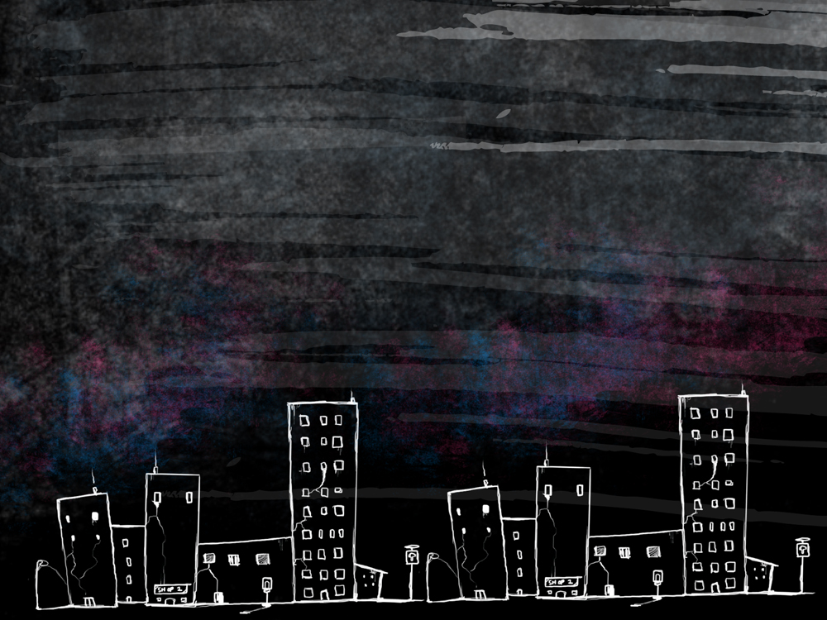
The Watson’s Go To Birmingham - 1963
Figurative Language in

Slide 2
Simile
A simile is a kind of figurative language that makes a comparison using ‘like or as’.
Ex: My father grumbles like a bear in the mornings.
I wanted our songs to fly out to the audience, but somehow they dropped like a lead beach ball.

Slide 3
Onomatopoeia
The use of words whose sounds echo their meaning.
The birds were fluttering their wings.
Yikes! I almost fell off my skateboard.
Mom said, “don't plop on the sofa".
I love to hear my cat purr.
Poof! The magician made the rabbit disappear.
The pipes rattled in the basement.
I heard the tires screech as he tried to put on brakes.
The fire crackled as it kept us warm from the fireplace.
The steaks sizzled on the grill.
We heard the lion roar.

Slide 4
Metaphor
A kind of figurative language that compares two things that are basically unalike. Unlike a metaphor, a simile does not contain ‘like or as’ but sometimes contains ‘is or was’.
Ex: My father is a bear in the mornings.
"Life is a journey. Enjoy the Ride."

Slide 5
Hyperbole
A kind of figurative language in which the truth is stretched, or exaggerated, for emphasis or humorous effect.
Ex: It was so cold, I saw polar bears wearing jackets.
“
She is so dumb, she thinks Taco Bell is
a Mexican phone company.

